Slide 1
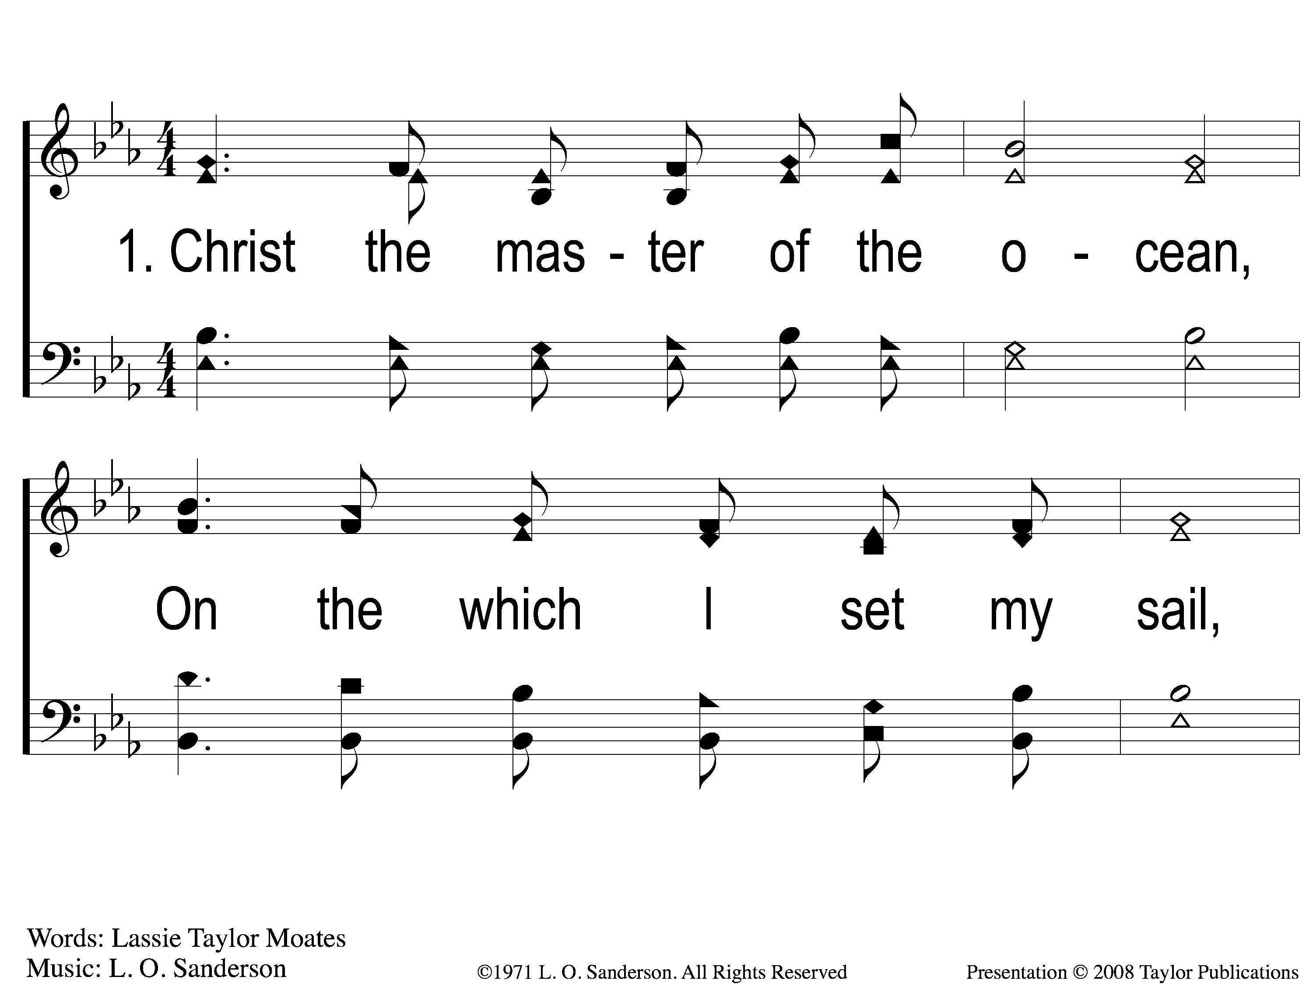
1-1 Gracious Pilot Straitly Guide Me
Gracious Pilot Straitly Guide Me
124

Slide 2
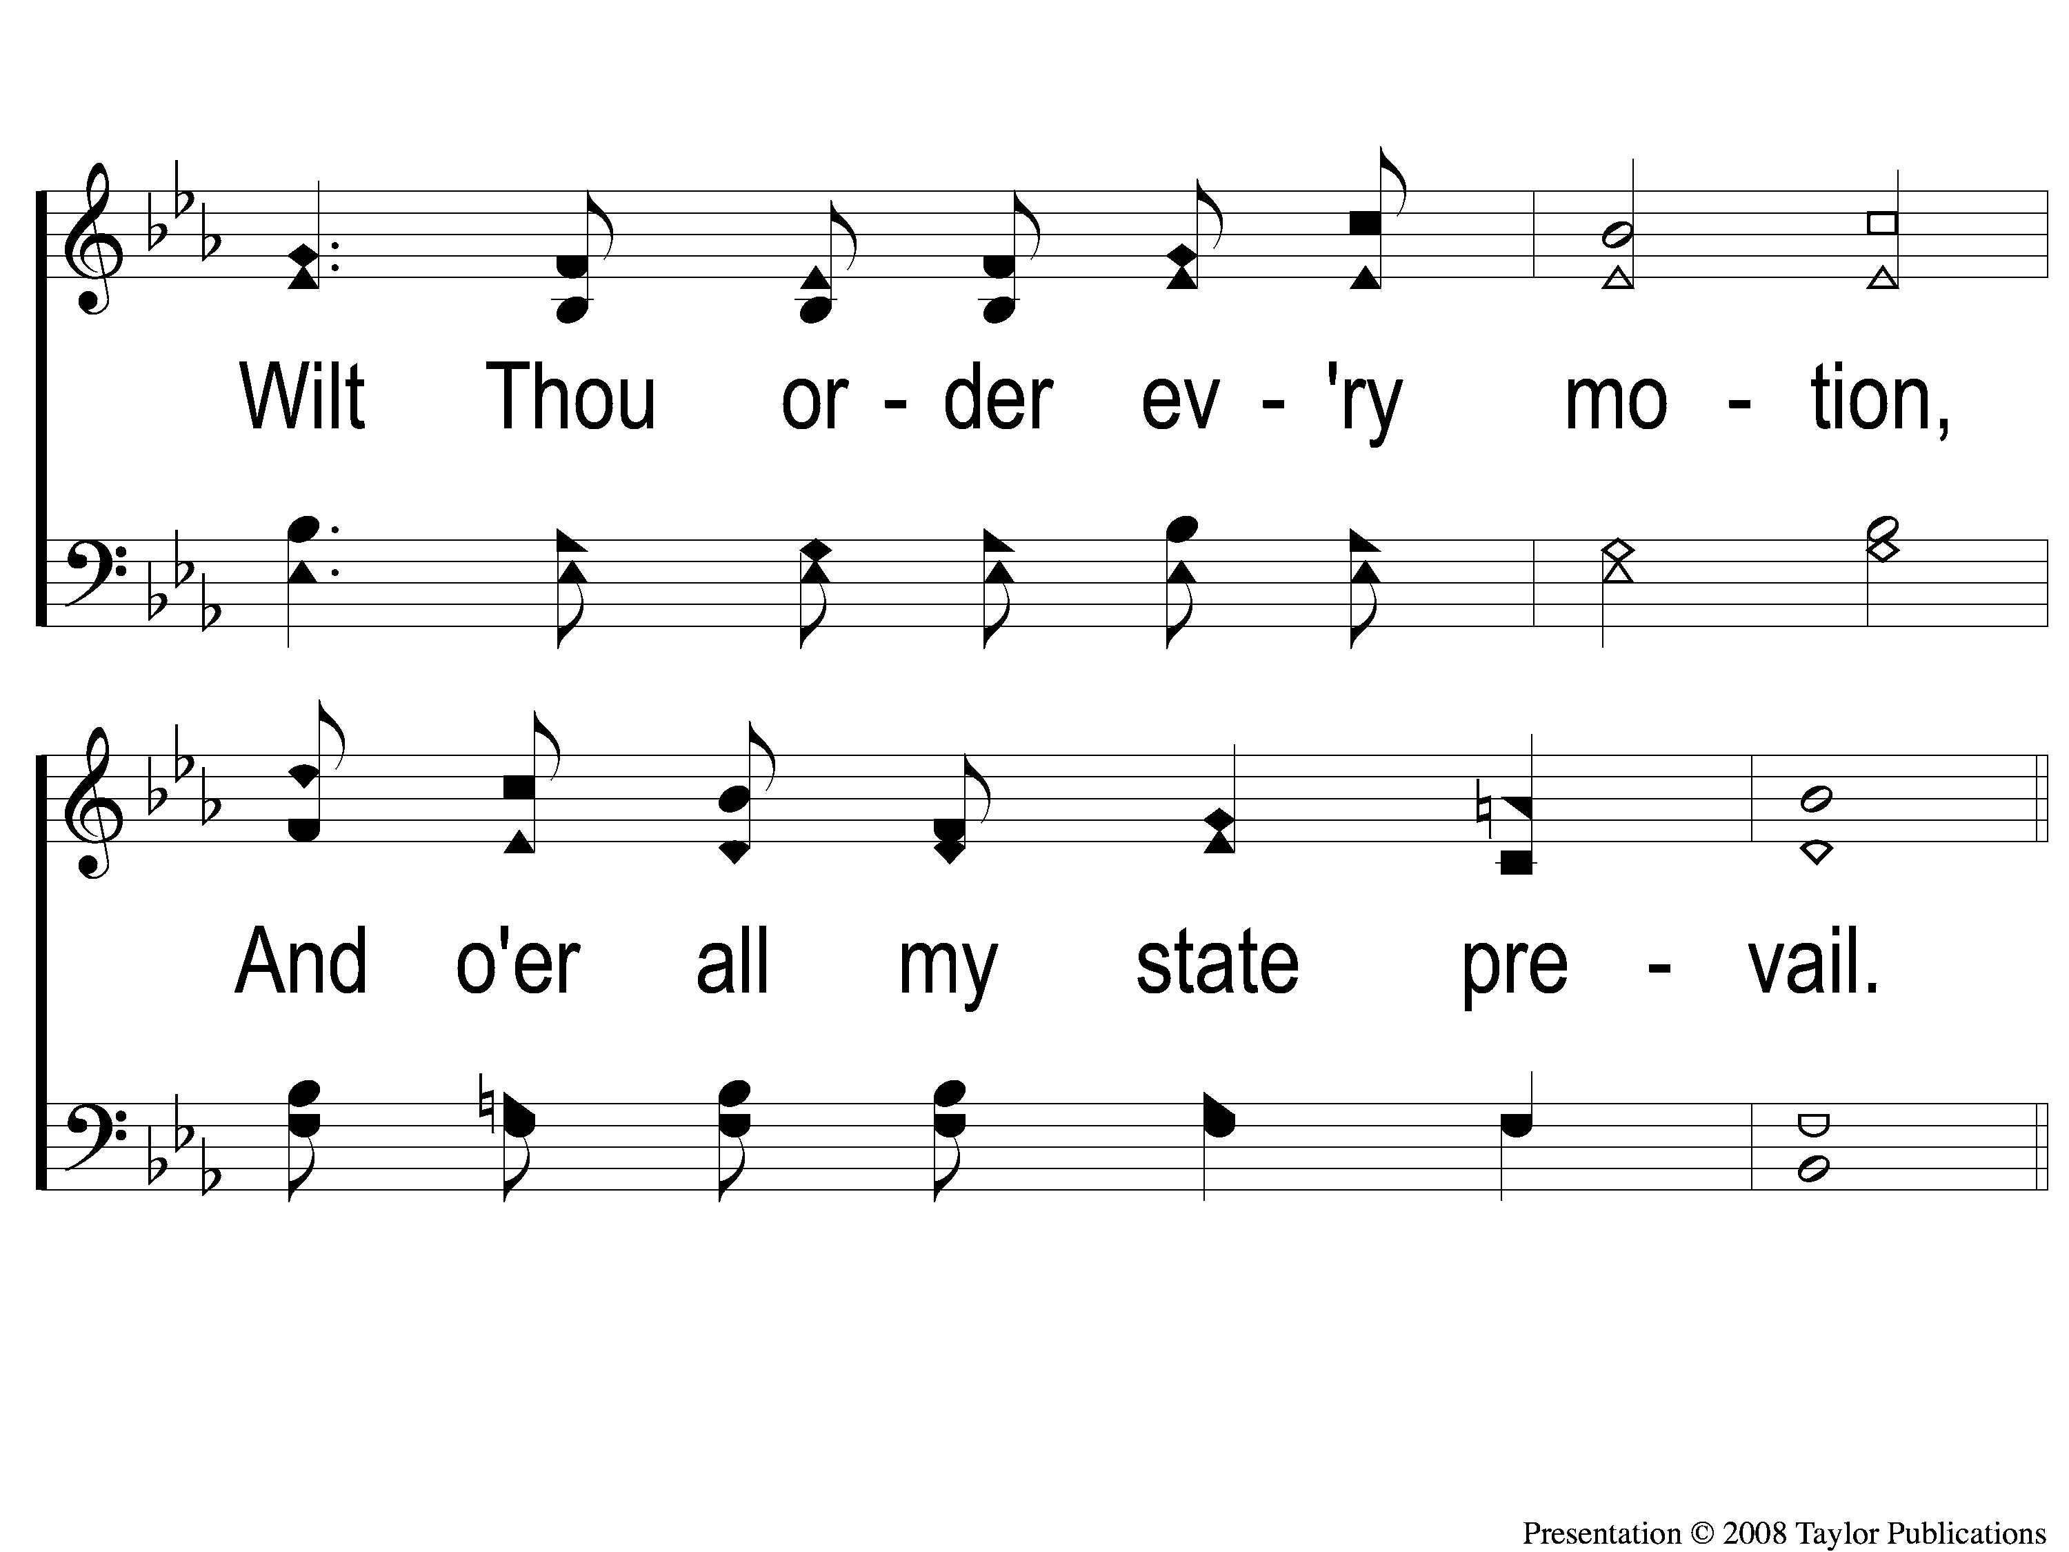
1-2 Gracious Pilot Straitly Guide Me
Gracious Pilot Straitly Guide Me
124

Slide 3
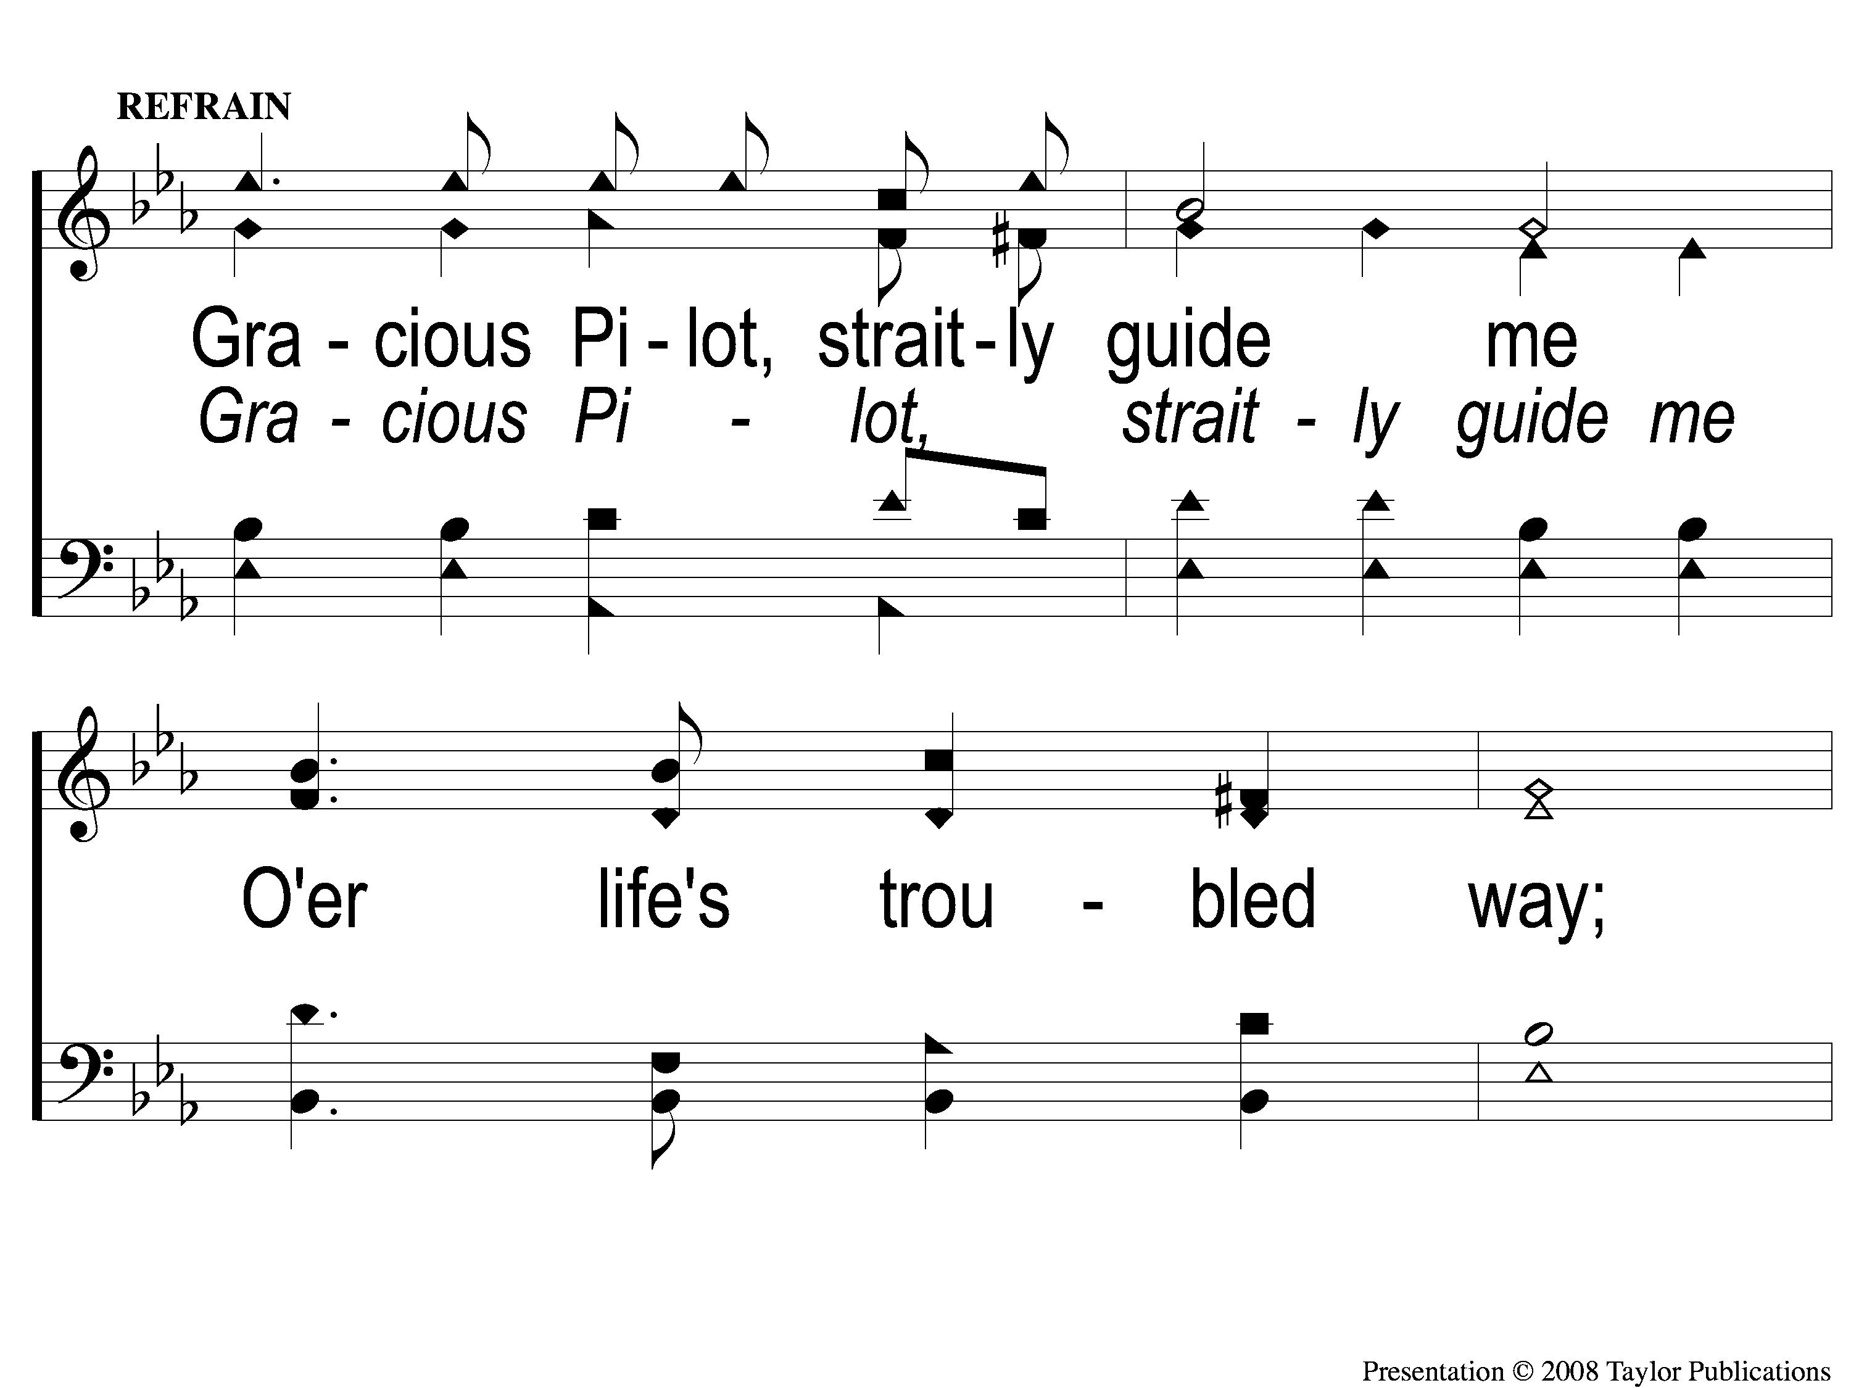
C-1 Gracious Pilot Straitly Guide Me
Gracious Pilot Straitly Guide Me
124

Slide 4
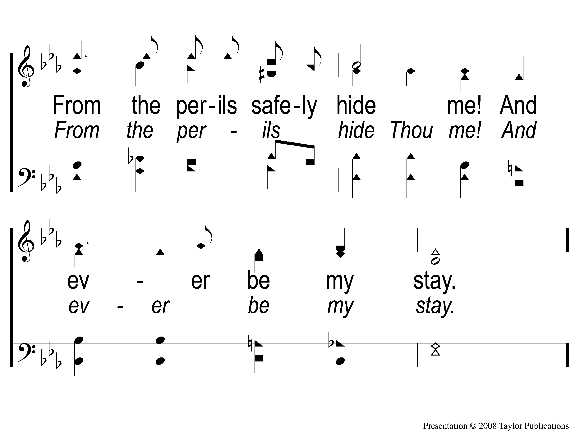
C-2 Gracious Pilot Straitly Guide Me
Gracious Pilot Straitly Guide Me
124

Slide 5
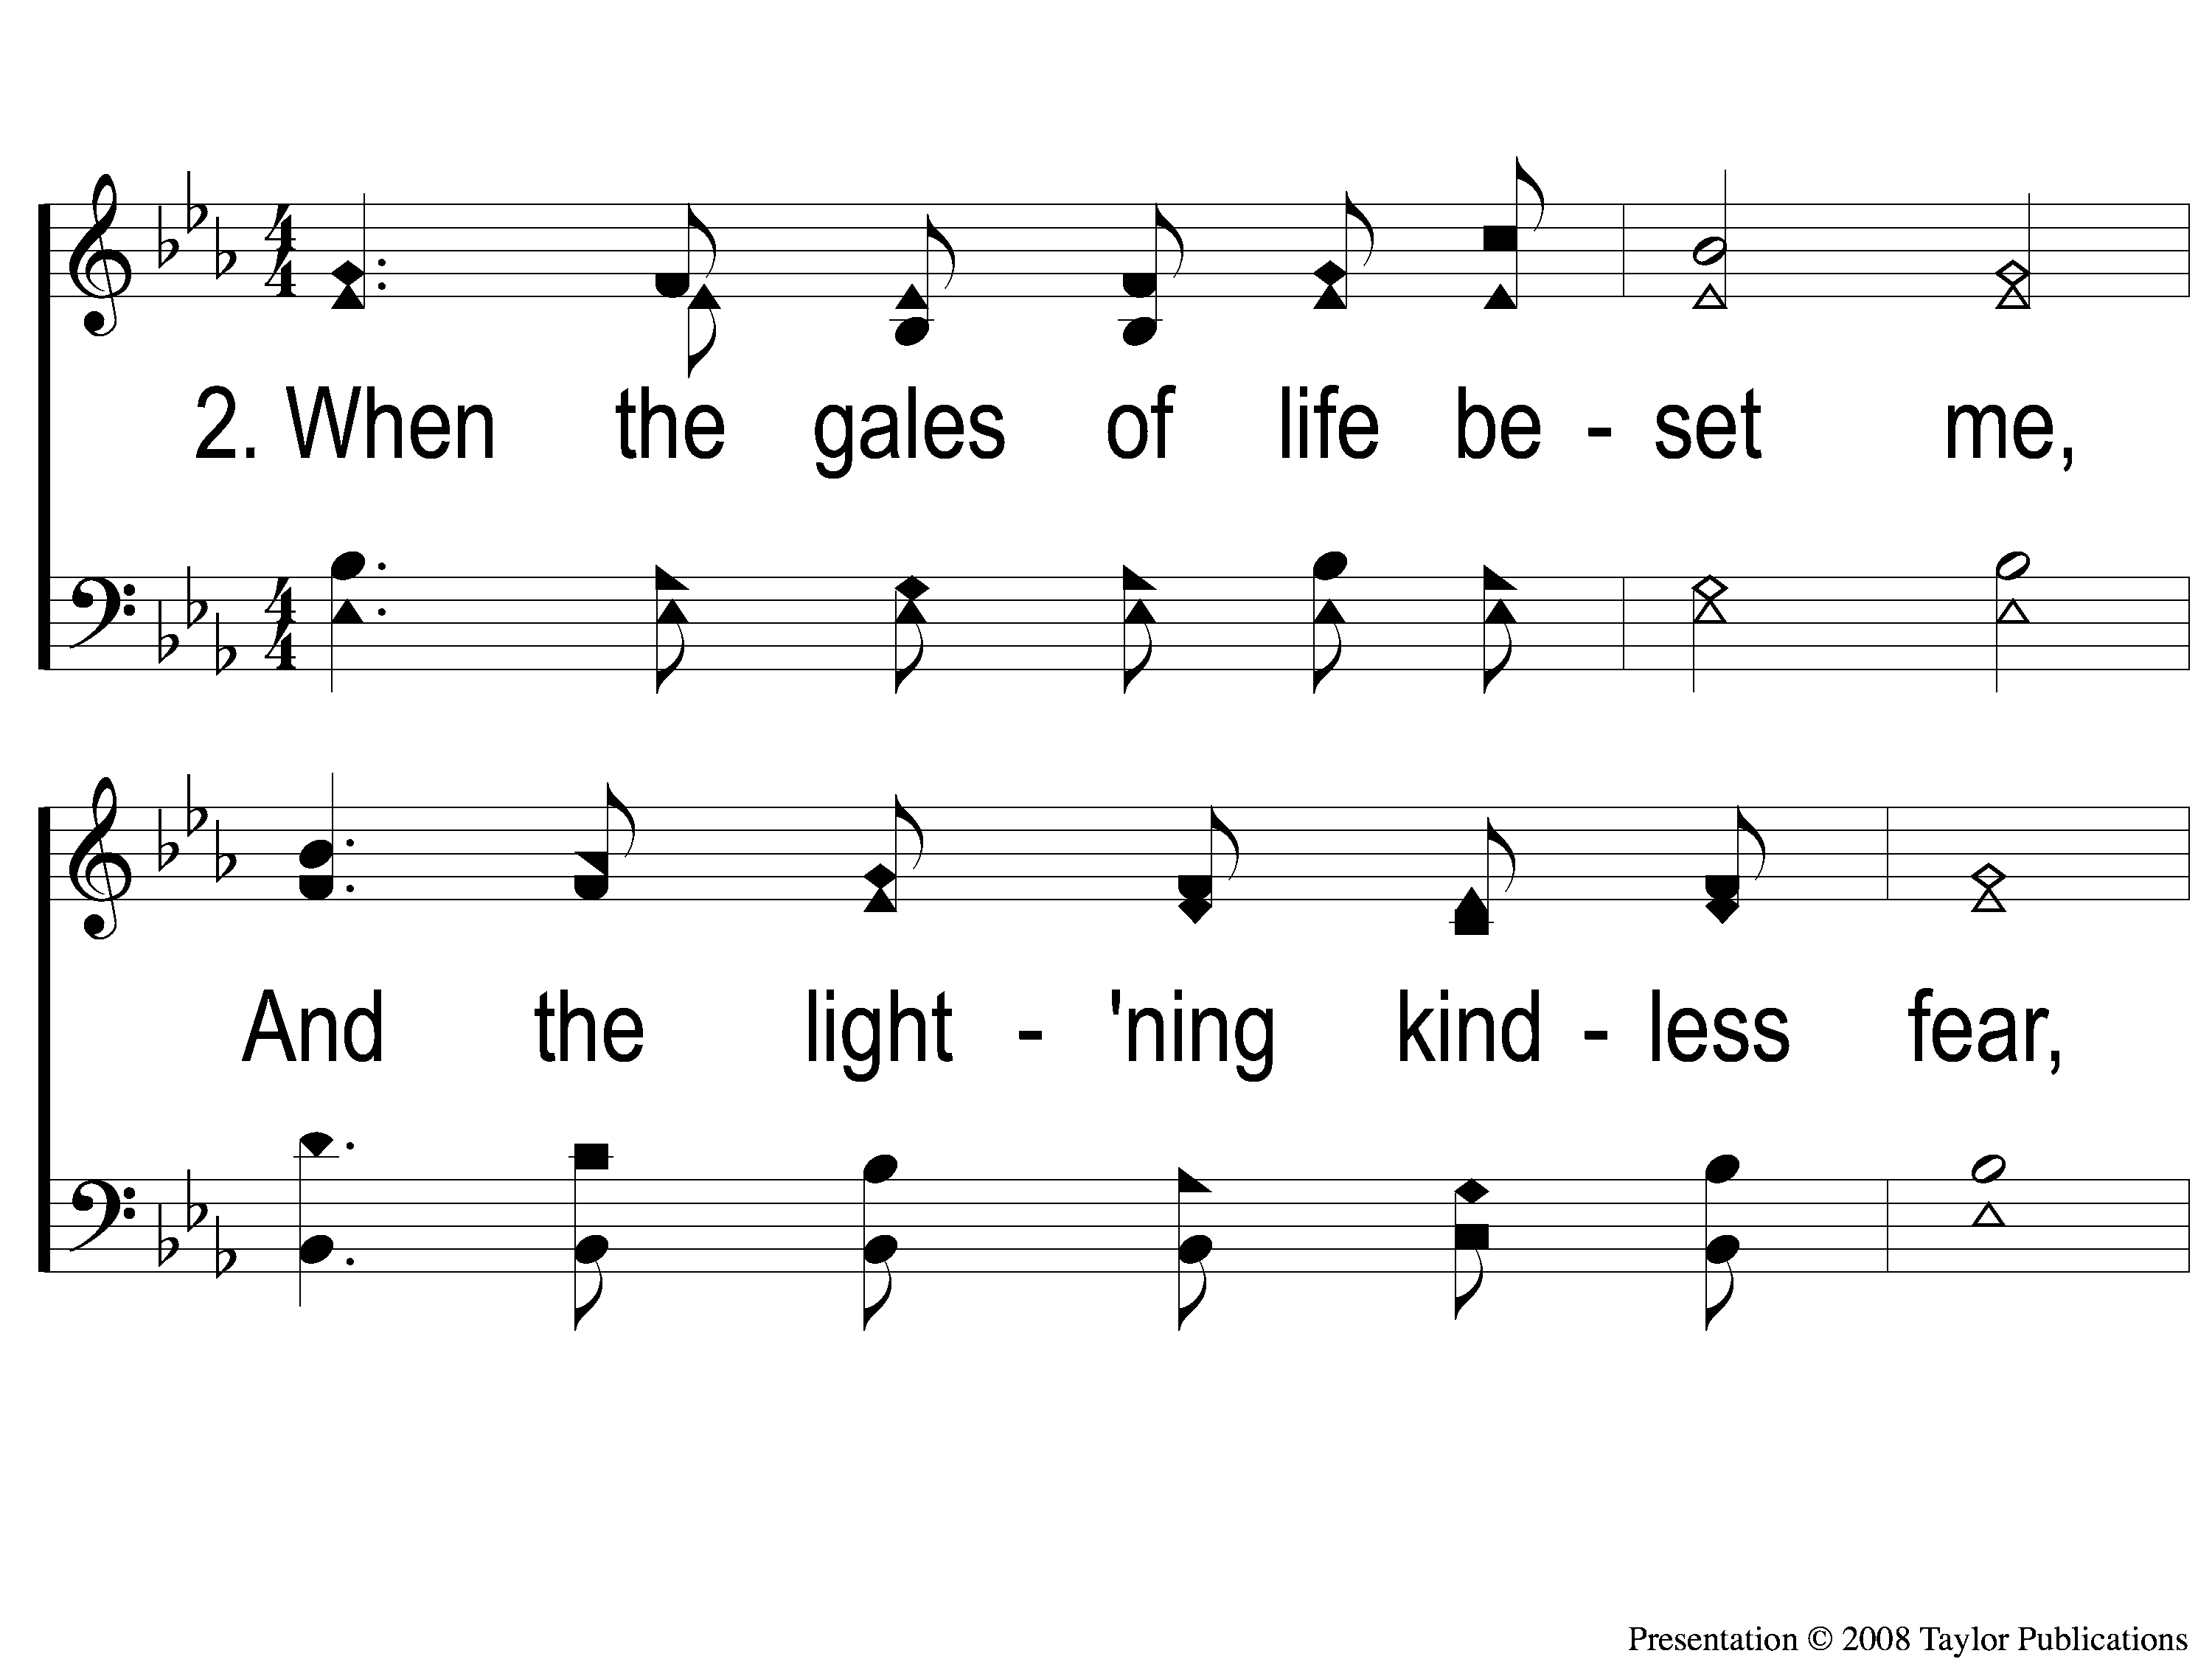
2-1 Gracious Pilot Straitly Guide Me
Gracious Pilot Straitly Guide Me
124

Slide 6
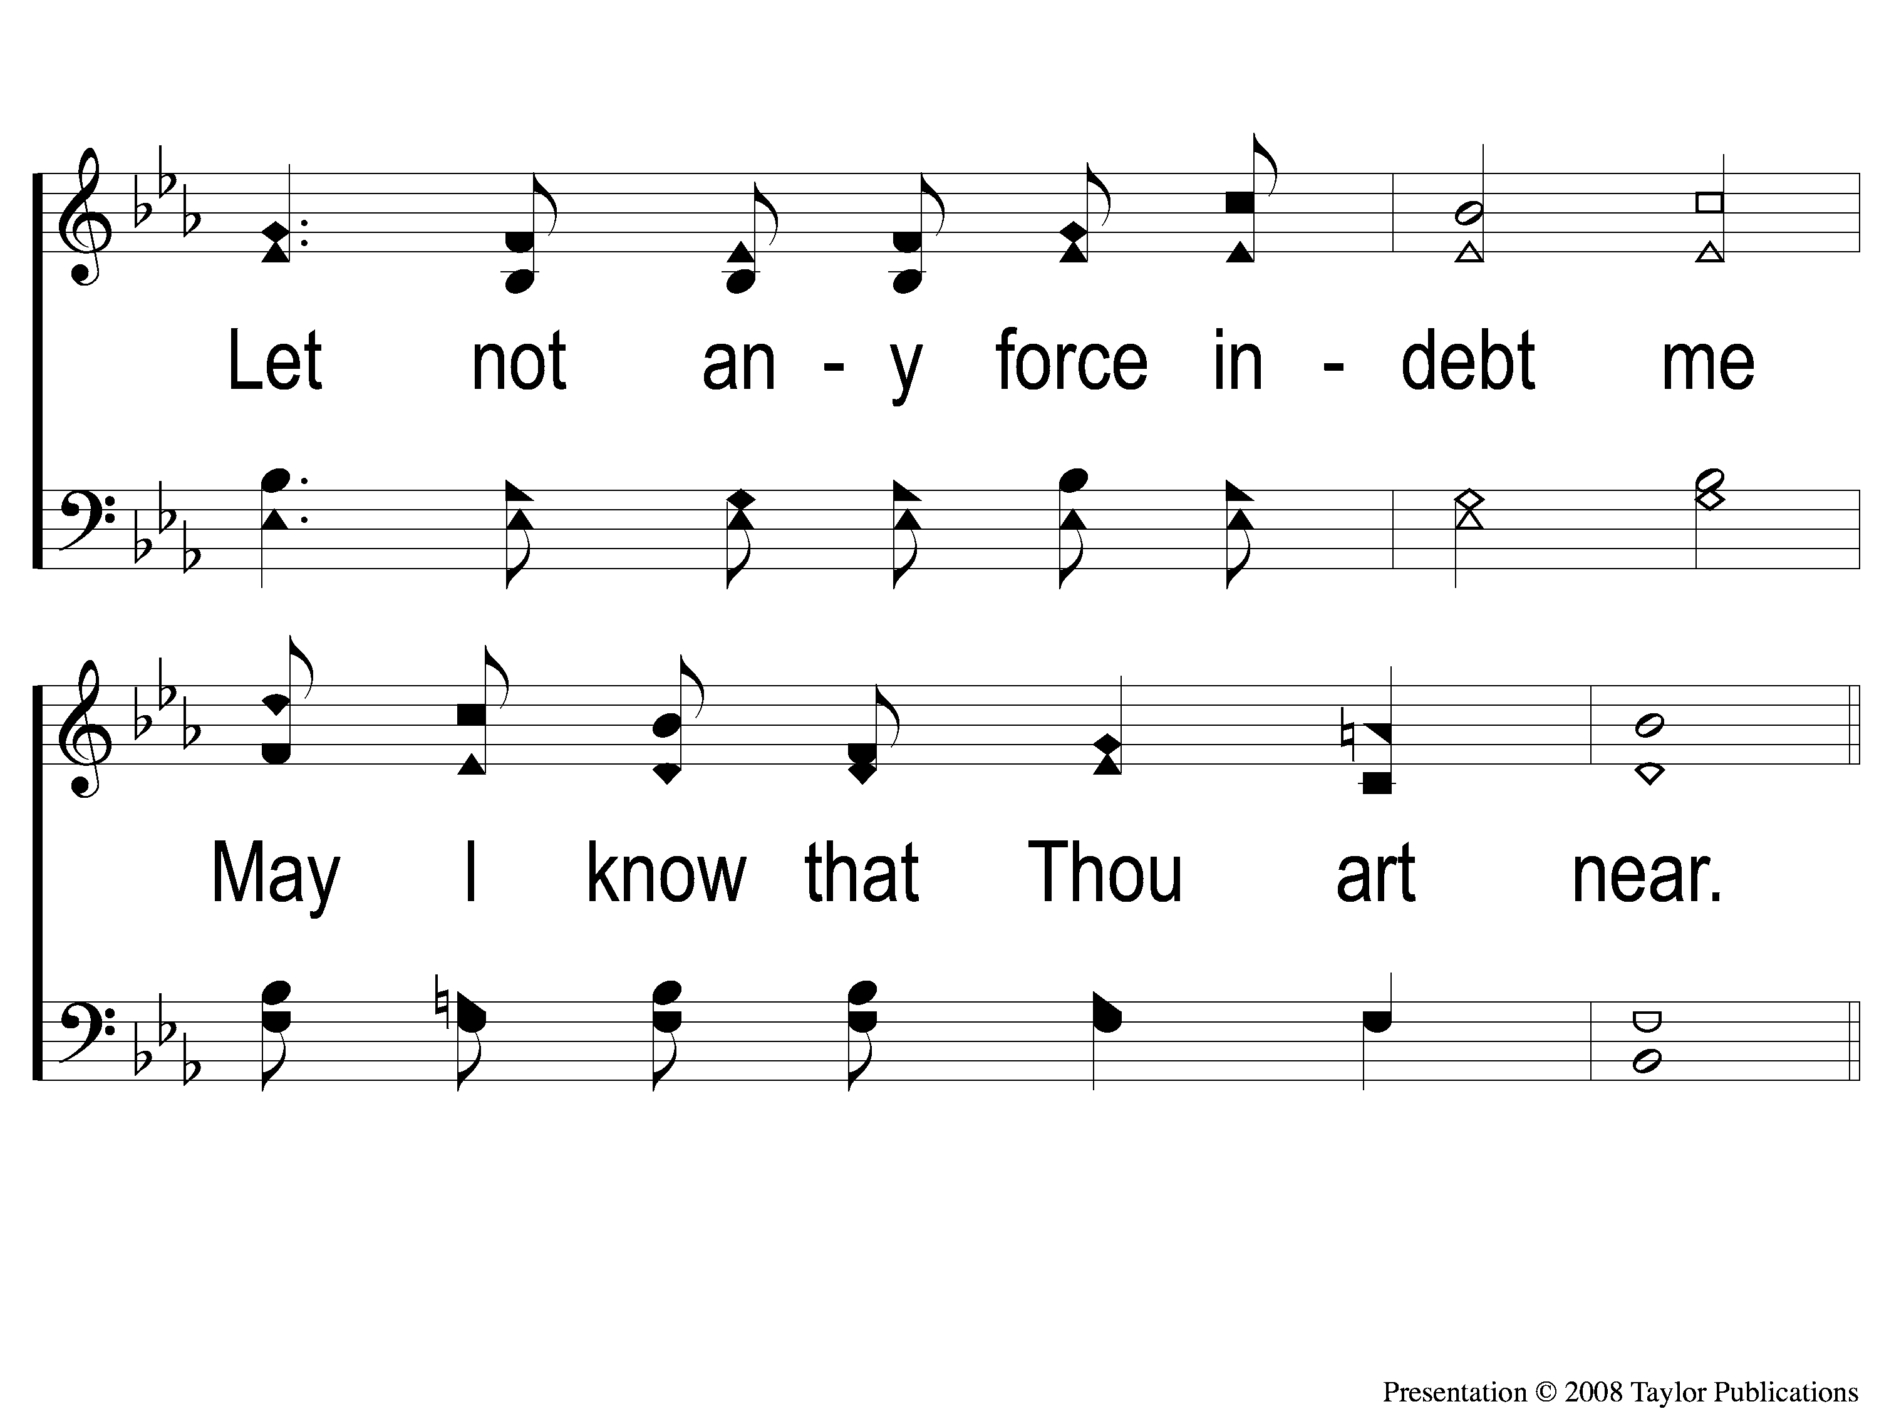
2-2 Gracious Pilot Straitly Guide Me
Gracious Pilot Straitly Guide Me
124

Slide 7
C-1 Gracious Pilot Straitly Guide Me
Gracious Pilot Straitly Guide Me
124

Slide 8
C-2 Gracious Pilot Straitly Guide Me
Gracious Pilot Straitly Guide Me
124

Slide 9
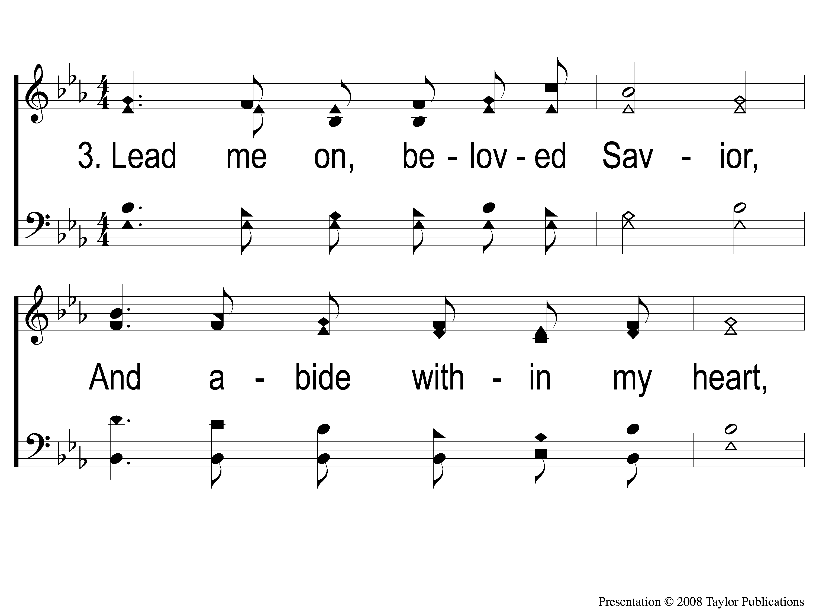
3-1 Gracious Pilot Straitly Guide Me
Gracious Pilot Straitly Guide Me
124

Slide 10
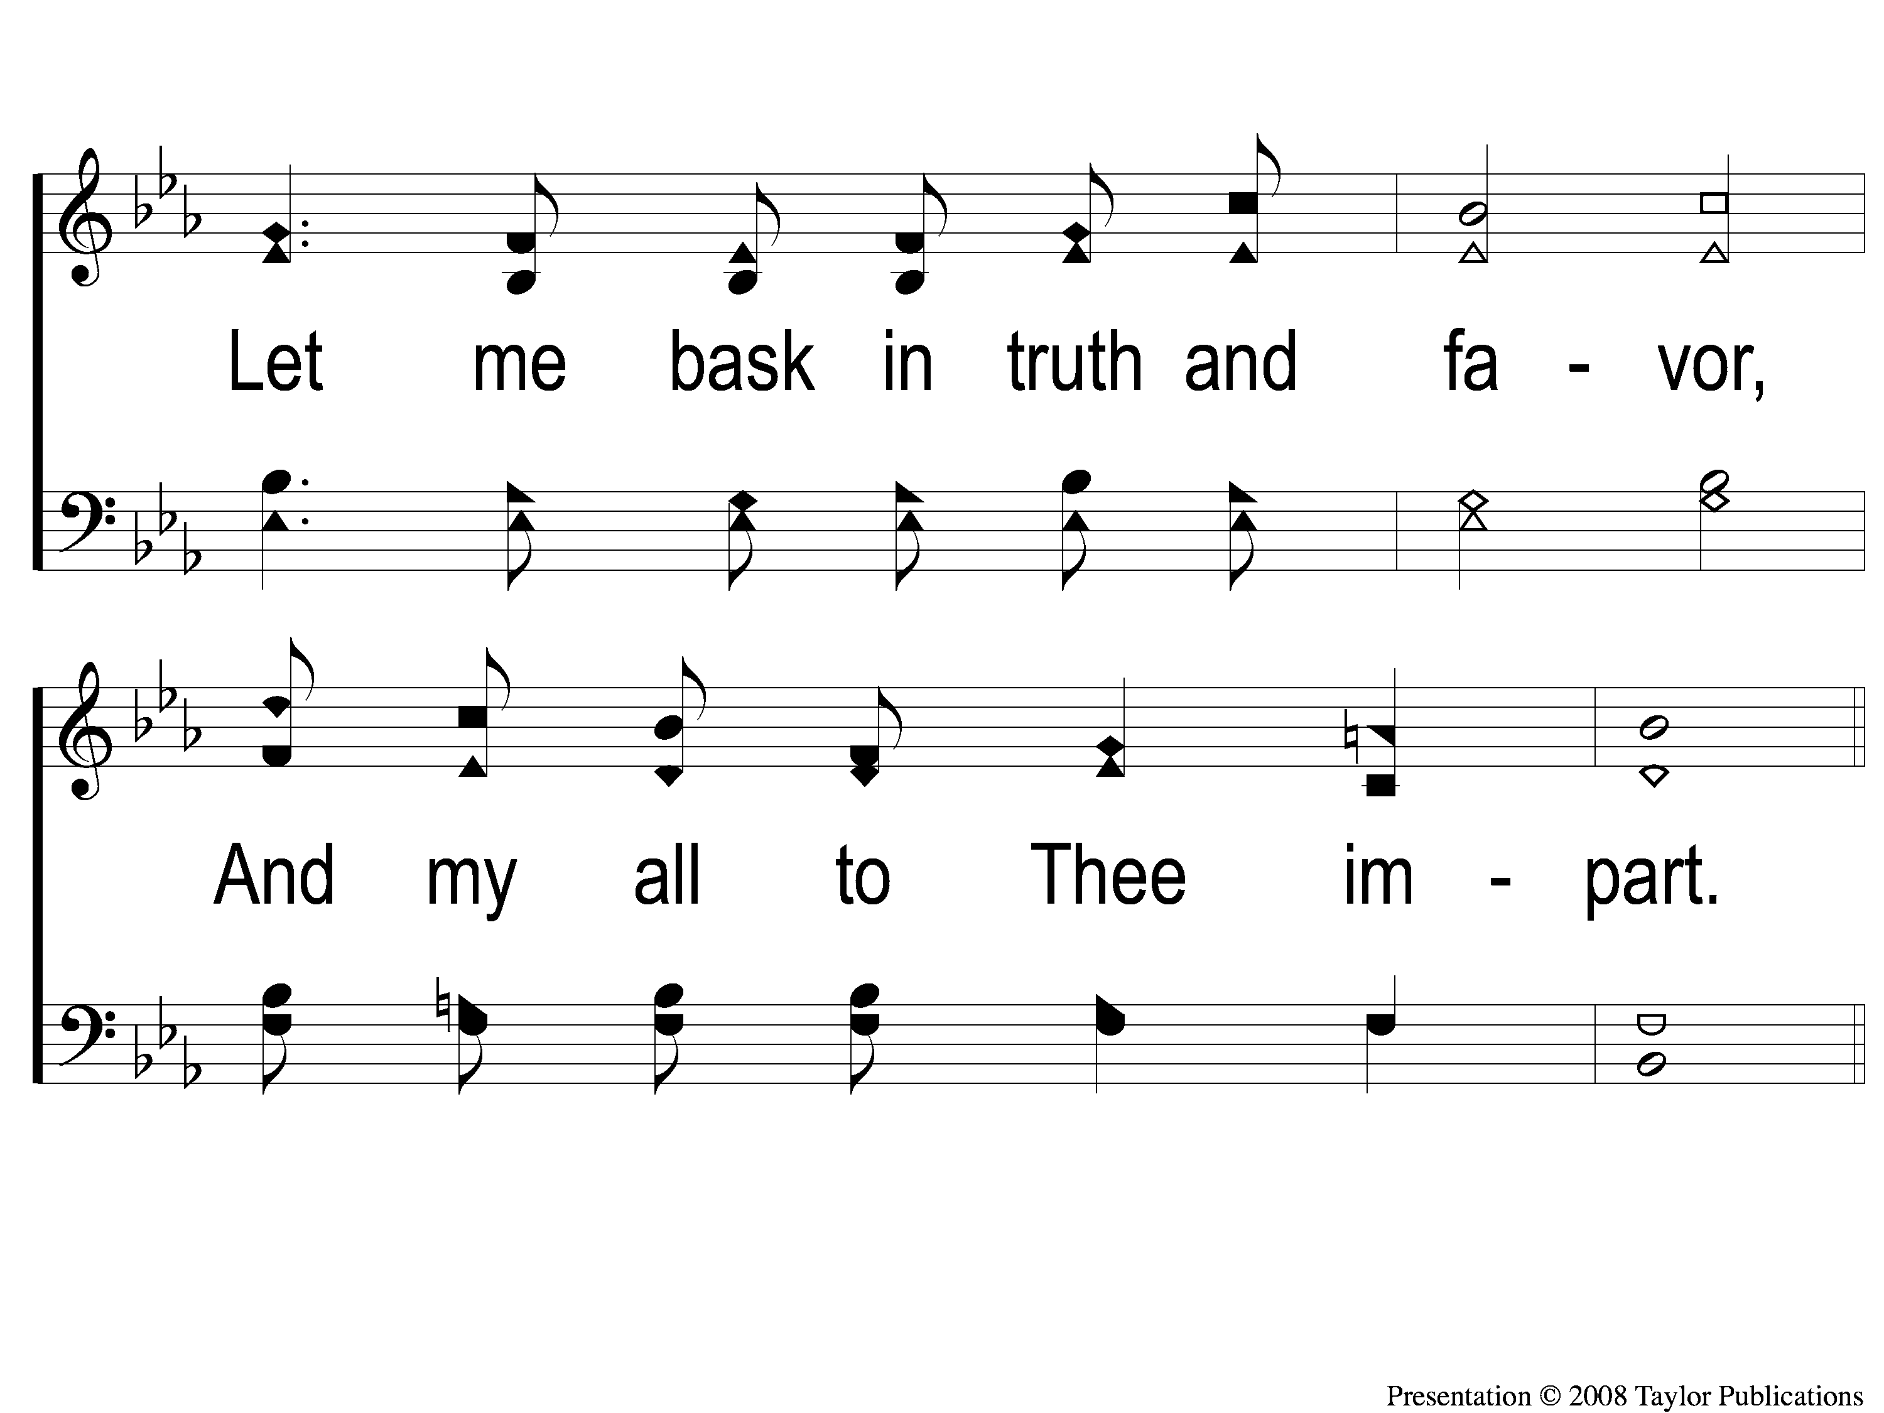
3-2 Gracious Pilot Straitly Guide Me
Gracious Pilot Straitly Guide Me
124

Slide 11
C-1 Gracious Pilot Straitly Guide Me
Gracious Pilot Straitly Guide Me
124

Slide 12
C-2 Gracious Pilot Straitly Guide Me
Gracious Pilot Straitly Guide Me
124

